Slide 1
CONNEXION COLLABORATORS
TEAM 5:
AARON LEE • LAU JUN RONG • JAMES LIM •
CHRISTINE TAN • RYAN TAN

Slide 2
TABLE OF CONTENTS
01.
02.
03.
04.
PROBLEM
STAKEHOLDERS
SOLUTION
EVALUATION
How did we arrive at this problem?
Who are the important stakeholders and why?
What do we propose to solve the issue at hand and why?
Measuring Success
Notes:
Good afternoon everyone, this is our presentation outline and we shall begin with the problem definition

Slide 3
01.
Problem
How did we arrive at this problem?

Slide 4
PROBLEM STATEMENT
Increasing Engagement in the Local Arts scene by utilizing Spare Capacity in SMU Connexion
Notes:
Our problem statement is to increase engagement in the local arts scene by utilizing spare capacity in SMU Connexion

Slide 5
PROBLEM STATEMENT : WHY ARTS?
Growing Arts & Creative Industry
Rising Viewership for the Arts in Singapore
However, lesser students are taking up the Arts
Notes:
So why should we focus on the arts. Firstly, the arts and creative industry has seen significant growth over the year and In 2015 it is estimated to have generated 2,250 billion in revenue globally
In Singapore, there has been a rising viewership trend for the arts and in 2018, a record high attendance at arts and cultural events was set.
However, while the arts seems to be popular, there has been a steady decline in the enrolment of arts courses which suggests that perhaps there needs to be more engagement in the local arts scene so as to change perceptions regarding the arts.
Reference (no time to explain)
Cultural Times, a report by UNESCO and EY published in 2015 demonstrates this by investigating the cultural and creative industries globally. It is estimated that it generates 2,250billion in revenue and 29.5million jobs globally. In Singapore alone, the arts and culture sector was estimated to have contributed approximately S$1.6 billion to the economy in value-added terms in 2013. The figure has burgeoned from S$43 million in 1986 and S$922 million in 2003, as stated in Singapore Cultural Statistics 2015 Report.
In 2015, according to the Singapore Cultural Statistics report, the government provided S$595.7 million or 80 per cent of arts and heritage funding. Contrast this to the1988 Singapore Festival of Arts, where less than 10 per cent was borne by the Government
Rising viewership for the arts in Singapore (information from Singapore Cultural Statistics 2019)
Attendance at arts and cultural events hit a record high of 13.6 million
2.2 million attendance at ticketed events (higher than previous 4 years)
All-time high attendance of 11.4 million at non-ticketed events
From Singapore Cultural Statistics 2019 there is a Declining number of ppl in arts CCA groups as well as enrolment into arts schools - Full time enrolment in tertiary arts courses has been steadily dropping as well as students enrolled in arts related CCAs.
These points suggest that there is infrastructure and demand for the arts in Singapore, but with lesser students being interested in taking up the Arts, perhaps there is a need to increase the engagement in the local arts scene to change public perceptions about the Arts.

Slide 6
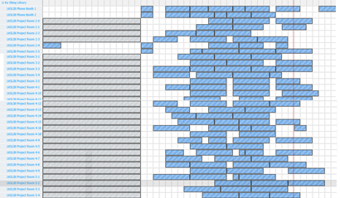
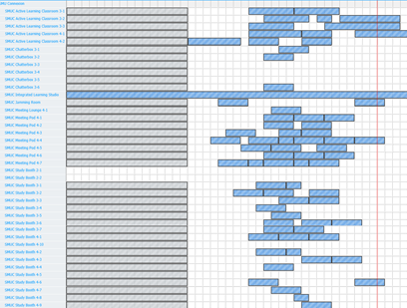
WHY SMU CONNEXION?
capacity analysis
LKS Library
CONNEXION
Total Hours Booked: 7476.6
Total Facilities: 44
Total Usage: 41.9%
Total Hours booked: 4377.25
Total Facilities: 40
Total Usage: 27.0%
Sample booking image from 4th Feb, Tuesday.
Sample booking image from 4th Feb, Tuesday.
Notes:
The second part of our problem statement is to utilize spare capacity in SMU Connexion.
So why Connexion in particular?
Based on a one month time frame, we compared the total usage of Connexion against that of LKS library which has a similar number of facilities and types of study spaces.
We defined the maximum bookable hours for each facility to be 14.5 hours; from 8am to 1030pm which allows us to calculate each Building’s “Usage” score,
that is given by (Total Hours Booked divided by the sum of the maximum Bookable Hours across all the facilities) .
In our calculations, we assumed that the usage is based solely on the bookable facilities.
And we can see that Connexion has a significantly lower usage rate of 27% as compared to the 41.9% of LKS and has spare capacity that can be utilized for the arts

Slide 7
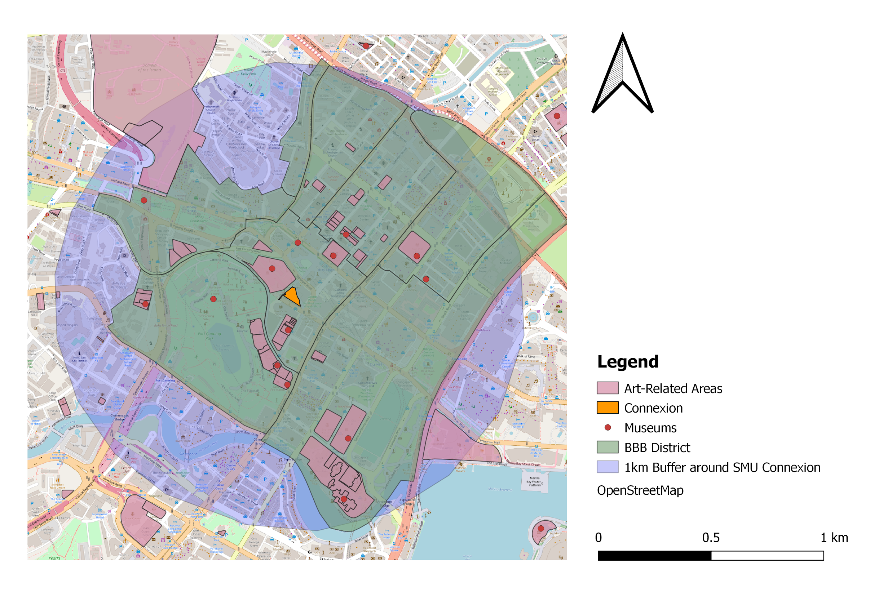
Geospatial Analysis
Centralised Location
SMU Connexion is in the middle of the BBB District, surrounded by almost 40 art-related places within a 1 km buffer.
Notes:
This is supported by a Geospatial Analysis of Connexion and its surroundings which highlights the fact that it is in prime location to become an Arts hub. As Connexion, which is the orange portion, is surrounded by almost 40 arts-related places within a 1 km buffer
Which is more than that of any other tertiary institutions.

Slide 8
02.
STAKEHOLDERS
Who are the important stakeholders and why?
Notes:
For our project, we have 5 main stakeholders

Slide 9


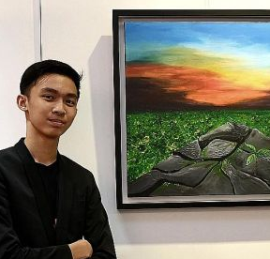


STAKEHOLDERS
smu students
Smu acf clubs
Art students
National arts council
Arts-related public
SMU Students make up the life of the university and play a significant role in most events in SMU.
ACF, also known as the Arts and Cultural Fraternity, is the overseer of the 23 Arts & Cultural clubs in SMU.
Art Students are well versed in the field of the Arts and make up a significant portion of local budding artists.
National Arts Council is the subsidiary governing body of our subject of interest.
The Arts-Related Public are the primary source of traffic for any Arts-related events that are hosted.
Notes:
They are, the SMU Students, who make up the bulk of the human traffic at SMU,
SMU ACF Clubs that hosts the bulk of arts related events at SMU,
Art Students from arts schools (like NAFA, SOTA, Laselle) that are well-versed in various forms of art and make up a significant portion of local budding artists,
The National Arts Council, which is the subsidiary governing body of our subject of interest,
And Lastly Arts-related public who are the primary source of traffic for arts-related events.
We “listened” to our stakeholders through various methods and analysed these results to extract key findings
3:20mins

Slide 10
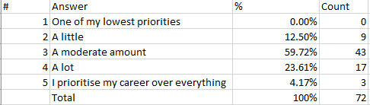
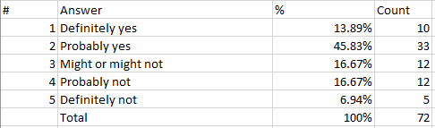
SMU STUDENTS
SURVEY
How career oriented are you?
Our survey had 78 respondents, of which they made out of students across all faculties and seniority.
Based on the results of the survey, we concluded that students are very career focused (88%) and have little time for the arts, although they (77%) have some interest in it.
Are you interested in the Arts?
Notes:
For SMU Students, we conducted a survey that had responses across the different faculties and seniority.
We found out that SMU students are highly career focused, and most of them do display an interest in the arts

Slide 11
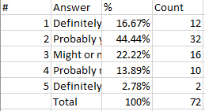
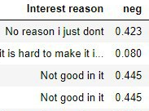
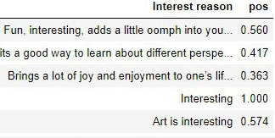
SMU STUDENTS - CLASSIFICATION MODEL
Feature engineering
Target variable: “Interest” (1/0)
- “"Will you be interested in a collaborative space for the Arts?”
Tagging of Interest Categories
Form of relaxation
Interesting
No exposure
No talent
Since young/CCA
Sentiment Analysis on “reason for interest/lack of”
VADER
Polarity scores
Notes:
We wanted to predict the “interest” for our potential solution, which is based on the if the student will be interested in a collaborative space for the Arts.
But before that, we performed feature engineering to seek out 2 additional features.
Based on the column of why they were/were not interested in the arts, We created 2 features:
The interest category and the sentiment polarity score

Slide 12
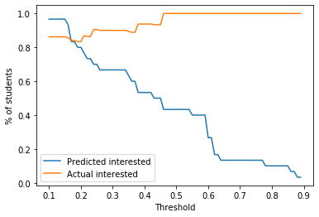
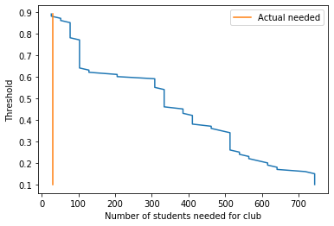
SMU STUDENTS - CLASSIFICATION MODEL
results
Logistic regression with L1 regularization
Factors affecting recruitment interest
Previous Arts CCAs (4x)
Participation in Art activities (1.9x)
Career oriented (0.5x)
We have a predicted interest rate of 43% and since we only need 30 students, we know that they would all be highly likely to join us. (87% likelihood).
n=30
Notes:
With all these features, we chose to use logistic regression for our classification model as the outputs are easily interpretable and we can perform L1 regularization easily, which eliminates features that may not be relevant.
We are then left with a few important features that predict the likelihood of their interest.
Such as if they have joined an arts CCA previously or participated in arts activities and how career oriented are they
Joined arts cca previously (4 times the odd for every unit of increase)
Participation in arts activities (1.9 times the odd)
How career oriented are they (0.5 times the odd)
Overall, our predicted interest rate is 43%, and on the top right graph, we can observe that the more “strict” we are with our threshold (which is the probability of being recruited) , the lesser students will be predicted to be interested but the likelihood of obtaining students that are actually interested increases.
And if we only need 30 students, they will have a high probability of 87% of being interested.

Slide 13
SMU STUDENTS - CLASSIFICATION MODEL
ALL negative Features
ALL positive Features
Variable: Career oriented
Coeff: -0.6484856778755097
Variable: Year_Year 1
Coeff: -0.9879602194530628
Variable: School_School of Accountancy Coeff: -1.6836832097239278
Variable: School_School of Economics Coeff: -2.212211125664561
Variable: Previous Arts CCA_Performance Coeff: 1.458853021975786
Variable: Previous Arts CCA_Sculpture
Coeff: 1.0436647726299912
Variable: Year_Year 2
Coeff: 1.0136934993274698
Variable: Participation in art activities
Coeff: 0.6799614931940257
Variable: pos
Coeff: 0.5806583753394504

Slide 14
SMU STUDENTS - CLASSIFICATION MODEL
results
This graph is plotted with the number of students being 770 (the number of profiles we collected from linkedin)
Hence, if we only need 30 students, we plug in our % of actual students interested and % of predicted actual, and then we know that these 30 students will have a ~87% probability of being interested to join us; and that is the highest probability threshold we can push for, and it is a reasonably high number.

Slide 15
SMU ACF CLUBS
WHO ARE THEY?
We conducted interviews with a representative from 16 clubs in SMU Arts & Cultural Fraternity. These interviewees are members of the executive committee of the club they represent.
WHAT DID WE LEARN?
From the interviews, we realised that many clubs viewed collaboration with other local clubs as a form of mutual benefit, as they learn different art styles from other clubs’ and it is good for boosting the local scene for their genre of art.
Notes:
From our next stakeholder, the SMU ACF clubs, we interviewed an EXCO (Executive Committee) member from 16 different clubs.
We learnt from them that many clubs emphasised collaboration with external clubs as it was mutually beneficial, such as learning of the different art styles which helps to boost the vibrancy of the local arts scene.
Now Christine will bring you through the rest of our stakeholders

Slide 16
ART STUDENTS
Survey
data.gov.sg
We have a total of 30 art students who were surveyed, with 13 coming from SOTA, 9 from NAFA and 7 from Laselle.
60% of the students are definitely interested in a collaborative space for the arts.. The common sentiment they have is that although the arts scene is growing, there is still limited exposure for them, with most being short-term.
We analyzed the yearly enrolment into the arts at the tertiary level from data.gov.sg..
The intake of arts students at the university level (Fine & Applied Arts) is on a downward trend. It decreased by 10.5% from 2016 to 2018. This suggests that less arts students are willing to pursue the arts as a career.
Notes:
Thanks Ryan. Now we will be looking at our 3rd stakeholder, Art Students. For our art students, we gathered information from 2 sources, a survey and from data.gov.sg. Firstly, our survey looked at the problems our local art students face and what they perceived the Singapore local art scene to be. From the results, we have learnt that most are interested in a collaborative space for the arts. Also, they think that although the local art scene is growing, exposure is still limited and mostly short term.
For the government data, we looked at the enrolment at the tertiary level for art schools, and we realised there was a downward trend of a decrease in more than 10% in 2 years.

Slide 17

NATIONAL ARTS COUNCIL (NAC)
We looked at NAC’s funding options, to determine whether our solution is capable of receiving funding or other forms of support from NAC.
WHAT NAC WANTS TO ACHIEVE:
Staging performances in schools to expose students to artists & their works
Offer non-monetary support in the form of resources, information, guidance for networking and showcasing.
Grants can be used for workshops, seminars, conferences, training & developmental programs.
To connect communities to come together to enjoy the arts
Create a platform to allow artists to share their works and collaborate
GRANTS WE ARE LOOKING AT:
Seed Grant:
For emerging non profit Arts Organisations to help kick start their projects.
Capability and Development Grant:
To encourage exposure and learning
Used for workshops, masterclasses, seminars, conferences, and many other skills development programs.
Notes:
Next, we will be turning our attention to National Arts Council. As NAC is the main governing body of which they have capital that we can leverage on, we looked at their funding options, to learn of what kind of projects they are interested in supporting. We also looked at their vision, and one of which is to create a platform to allow artists to share their works and collaborate. They also have 2 grants that are relevant to us.
7mins to 6:35mins

Slide 18



ARTs-RELATED PUBLIC
TripAdvisor
Instagram
Google Reviews
We performed Opinion Mining on the reviews of art-related places on TripAdvisor to identify what are the popular aspects that art-related public are interested in.
Similar to TripAdvisor, we found the popular art-related hashtags and posts to learn about the interest of this demographic.
From Google Reviews, we can retrieve the “popular times” of art-related places in the BBB District.
Notes:
Lastly, we have our arts related public. We looked through 3 sources to discover the interests of the arts related public. We will look into these 3 sources in detail.

Slide 19
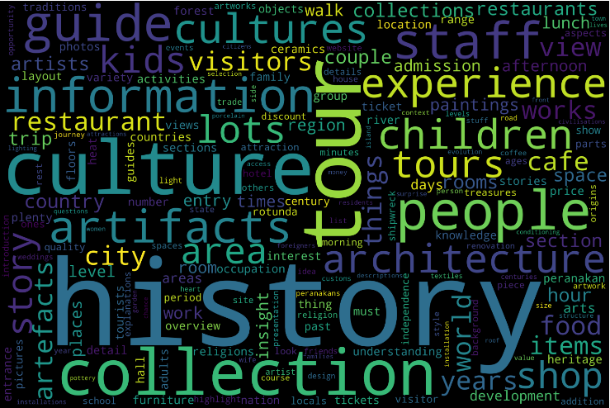
TripAdvisor
Opinion Mining
We collected 5615 TripAdvisor reviews of the 5 nearest museums to SMU. Each review was classified into 1 of 3 classes; “good”, “ok”, “bad” based on a weighted score, which comprised of 3 factors: Rating, Review Text Length and Sentiment Polarity Score.
Then, we proceeded to extract the aspect terms of all the reviews that were classified as “good” and created a frequency distribution of it. Common “stop” words that appeared across all three classes were also removed. .
Notes:
For TA, where we looked at the good reviews of the 5 nearest museums to SMU to see if we could learn what people liked about these places and apply that to our solution. Hence, we embarked on opinion mining on 500 reviews of the “good” reviews.
From 500 TripAdvisor Reviews of the 5 nearest museums to SMU with >=500 reviews (Asian Civilization Museum, National Gallery, National Museum, Singapore Art Museum, Peranakan Museum), we classified each review into 3 classes, “good”, “ok”, “bad” before extracting out the aspect terms from all the reviews.
The Classification was done using a weighted score (from -1 to 1) which comprised of 3 factors (corresponding weight for each factor given in the brackets); the rating score given in the review (0.5), the review text length (0.15) as well as the sentiment polarity score (0.35). The sentiment polarity score was obtained using the sentiment polarity library from TextBlob. If the review had a rating that was 20 out of 50 and below and had a negative sentiment polarity score, the review score and text length were made to make the total weighted score more negative. Reviews that had a weighted score of <0 was “bad”, above 0.6 is “good” and the rest is “ok”.
We then grouped all the reviews by their classes and extracted out all the aspect terms in each review class. We were primarily interested in only the “good” aspects, but we had to remove common words across the 3 classes so that we are more likely to obtain the words that contributed to the positive reviews as they were only found in these class of reviews.
This lets us identify common aspects of these arts related places that contribute to a positive review that we can utilize in our solution so as to attract the arts related public

Slide 20
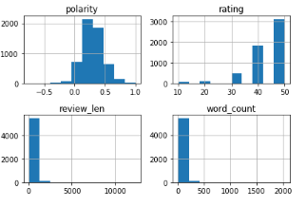
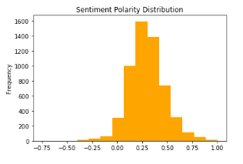
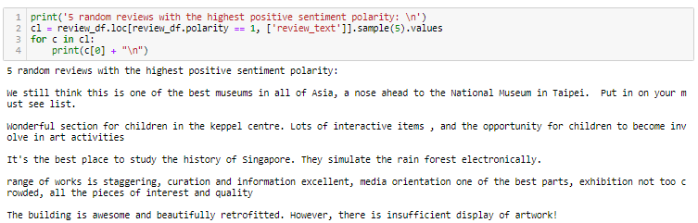
How we Did Opinion Mining and raw data output
Notes:
We analyzed the distribution of the terms we wanted to use for our weighted score. We can see that the distribution is mostly skewed, so we have to take note of it.
Sentiment polarity was obtained using TextBlob library → Sentiment Analysis function
We can see that it performs quite well as we randomly sampled the reviews for those that had the highest sentiment polarity score (positive reviews) and it seems to be working out well

Slide 21
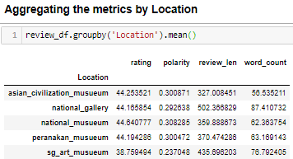
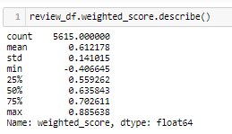
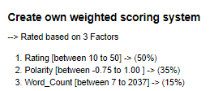
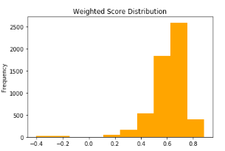
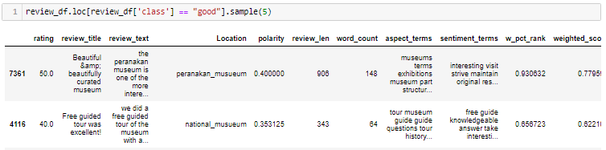
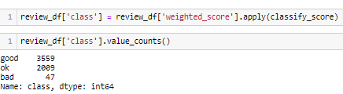
How we Did Opinion Mining and raw data output
Notes:
We used our own weighted scoring system to classify the reviews into “good”, “ok” and “bad”, and ended up having 3559 “good” reviews, which is much more than that of bad reviews, but we will try to mitigate these and separate the aspects that actually contributed to the review being good by removing words that are found in “ok” and “bad”.

Slide 22
TripAdvisor
Opinion Mining
These are the key findings after interpreting the cleaned aspects:
When viewing the museums, and the exhibits, they are mostly interested in the history and culture behind the exhibit as well as the artist that drew it
They enjoyed getting detailed information and explanations, especially from guided tours
They enjoyed the free aspects of it
It is mostly visited by families (with children) and couples
They liked to take pictures and photos of the highlights

Slide 23
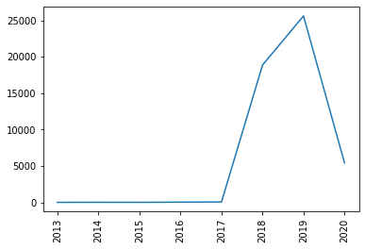
INSTAGRAM
#sgart
Having a total of over 100k Instagram posts, we can observe that the hashtag has only picked up in the recent years.
Notes:
Our 2nd source of data for arts related public is from instagram, where we look through the popular hashtags to find popular instagram posts. The top hashtag is sgart, which has more than 100k posts, and it has only picked up in recent years from 2017. This in line to what ryan has mentioned earlier, that the arts scene has been growing.
Since sg art is a broad hashtag, we decided to dive deeper, looking into the popular hashtags that are featured in posts with the sg art hashtag.

Slide 24
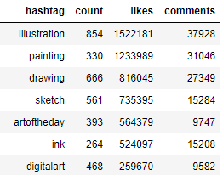
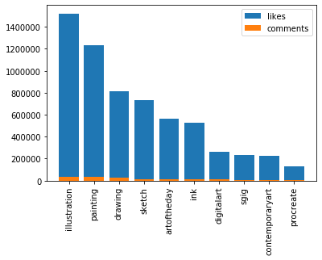
INSTAGRAM
top #hashtags
As #sgart is a broad term, we went to find out the top hashtags that were contained in posts with #sgart. We can see a common trend that the top hashtags have links to visual arts.
Notes:
So these are the top hashtags in order, and they are ranked by the number of likes and comments. Looking at the top few hashtags, we can see a link that most are related to more specifically visual arts.

Slide 25
INSTAGRAM
#illustration
Was the top hashtag in posts that contained #sgart, with the highest number of likes and comments. The number of likes it received were more than 1.5 million.
Notes:
10mins here

Slide 26
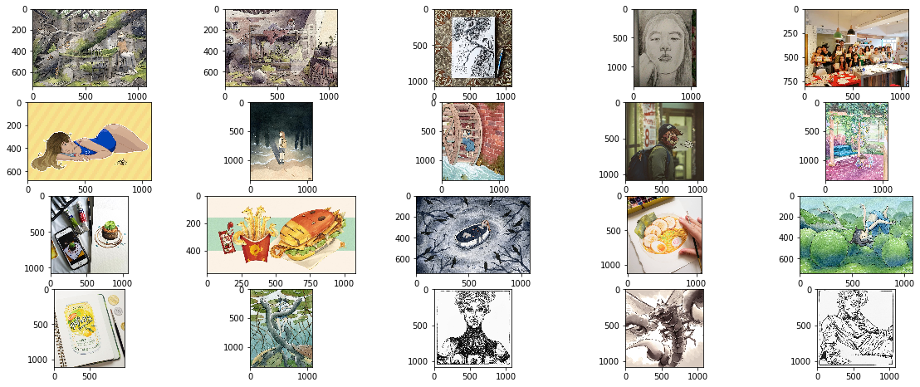
INSTAGRAM
#illustration
The top posts (likes, comments) with the above hashtag are seen below.

Slide 27
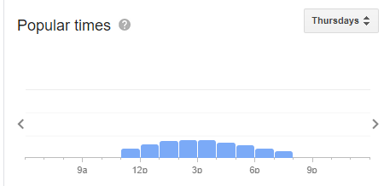
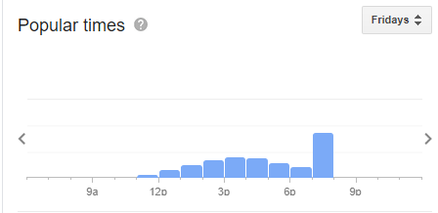
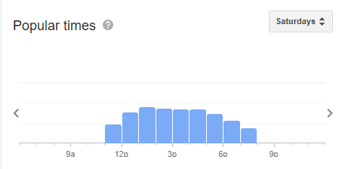
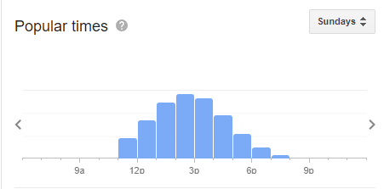
Google Reviews
Popular Visiting Timing Analysis
From Museums and Art Jamming Cafes, we extracted out the popular times for each location across the days of the week.
Identify common visiting patterns across all locations
Source: Google Reviews “Popular Times” - Art Courses in Singapore Visual Arts Centre
Notes:
Lastly, for arts related public, we looked into google reviews to to identify the visiting patterns for each place. We extracted out the charts of the “popular times” of the arts related places for every day of the week.

Slide 28
Google Reviews
Popular Visiting Timing Analysis
These are the key findings across Art-related places:
Most of the peak periods are at 12-3 pm on weekdays.
Spikes on Friday evening
Saturdays and Sundays have the highest average traffic. Mostly popular throughout the day, but saturday night have peaks while sunday after 6pm is usually lower.
Notes:
Other than the usual,
-peak weekdays 12-3pm
- although peak on weekends, 6pm sunday is lower
Hahah christine try to type a script so youll be faster n smooother

Slide 29
STAKEHOLDERS
smu students
Smu acf clubs
Art students
National arts council
Arts-related public
SMU Students are very career oriented and although they may have some interest in the arts, they have little time spent on it.
SMU ACF Clubs are interested in collaborating with arts students so that they can learn from each other.
Art Students lack funding and exposure, and are interested to learn from like-minded artists.
NAC have the vision to increase collaboration in the arts scene and are willing to support non profit projects that have such aims.
Arts-Related Public are mostly interested in history and culture, and the visual arts. They also like free events that are family friendly.
Notes:
Findings about the individual stakeholders:
SMU Students - SMU Students are very career oriented and although they may have some interest in the arts, they have little time spent on it.
SMU ACF - interested in collaboration with local artists to learn from each other
Art students - lack funding exposure and collaboration opportunities
NAC - have grants to fund projects that will increase collaboration of the arts and for non profit projects
Arts-related public - want free events and are mostly interested in visual arts, history and culture. Our solution also should be family friendly
3:25

Slide 30
03.
THE SOLUTION
What we propose to increase engagement in the local art scene

Slide 31
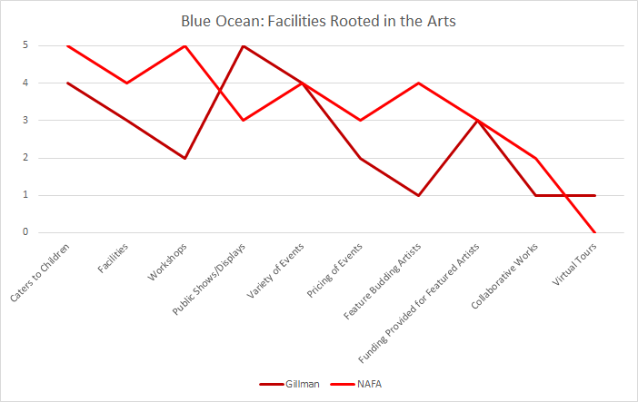
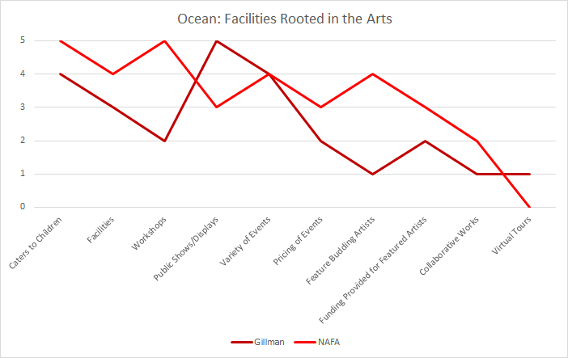
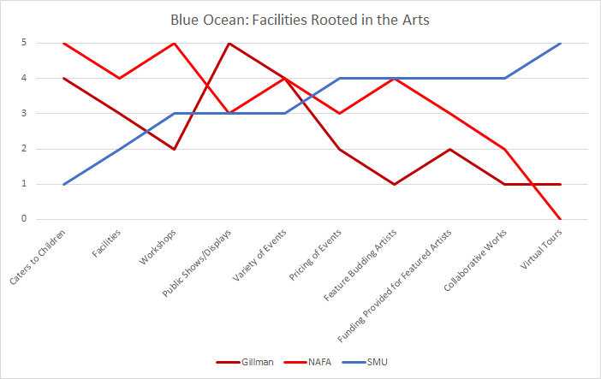
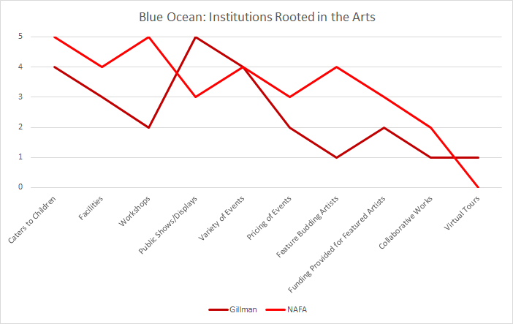


Blue Ocean Strategy
Notes:
We first conducted a blue ocean strategy to determine how we can create a solution that will be impactful and unique.
We first did a Red Ocean analysis on Institutions rooted in the Arts. The 2 cases we decided to analyze were Gillman Barracks and NAFA. To give you a brief overview, Gillman Barracks hosts art exhibitions featuring famous foreign and local artists whereas NAFA is an arts school focusing mainly on teaching and hosting exhibitions occasionally.
Looking at the maroon and red lines, we discovered that Gillman and NAFA score well in categories such as catering to children, good facilities, host frequent workshops etc.
However, they seem to be lacking in the following categories: Feature budding artists, Funding provided for featured artists, Feature collaborative works btw artists and lastly Virtual Tours.

Slide 32
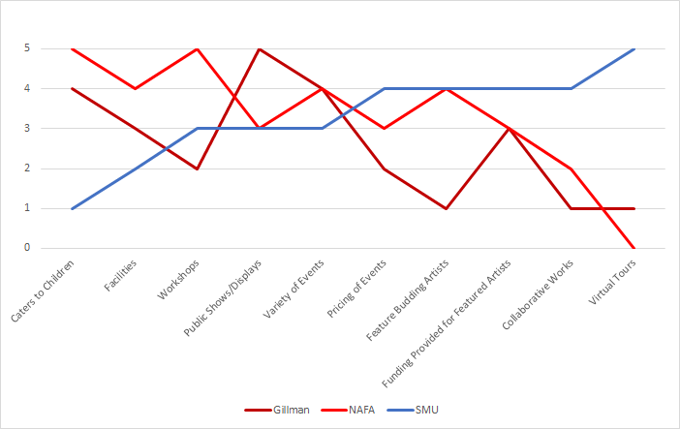
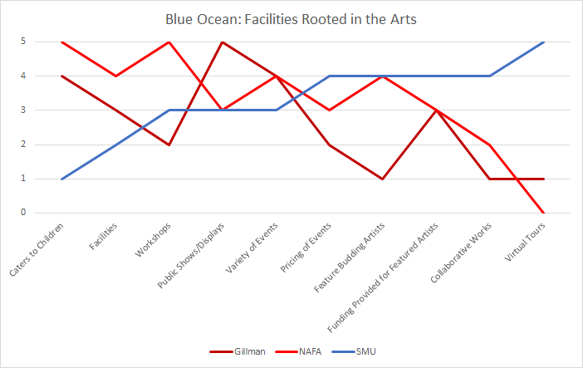
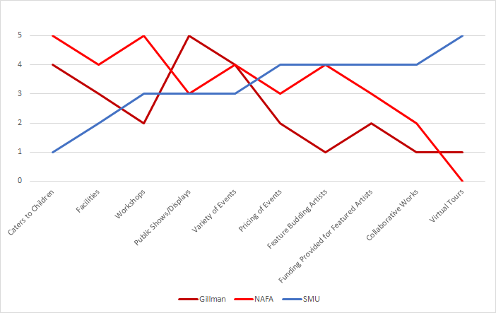

Blue Ocean Strategy
Eliminate
reduce
Raise
Create
Notes:
With these new insights in mind, we knew that we wanted our solution to focus more on the categories that the other 2 institutions were lacking in. We classified these categories under RAISE and CREATE as shown in the graph.
As much as possible, we wanted our solution to avoid categories that the other 2 facilities were strong in, as we did not want to compete in an existing market space.

Slide 33
PUTTING EVERYTHING TOGETHER
Blue Ocean Strategy
Feature Budding Artists
Funding Provided for Featured Artists
Collaborative Works
Virtual Tours
Stakeholders’ wants
Increase in Exposure
Increase in Funding
Collaborative Platform among Fellow Artists
Increase Outreach through use of Technology
Connexion Collaborators
Notes:
So just a quick summary of what we’ve covered thus far, we know that our stakeholders, mainly Art Students, are interested in increased exposure and funding, and they also find great benefit in collaborative works between artists in the same field of Art. This is very similar to what we found in SMU ACF Clubs, who also find great interest in collaborating with fellow artists.
Regarding our findings from the Blue Ocean strategy, we know we want out solution to focus on featuring budding artists, providing funding for featured artists, feature collaborative works and incorporate the use of Virtual Tours. Putting everything together, our group thought that Connexion Collaborators is the perfect solution to marry these 2 together.

Slide 34
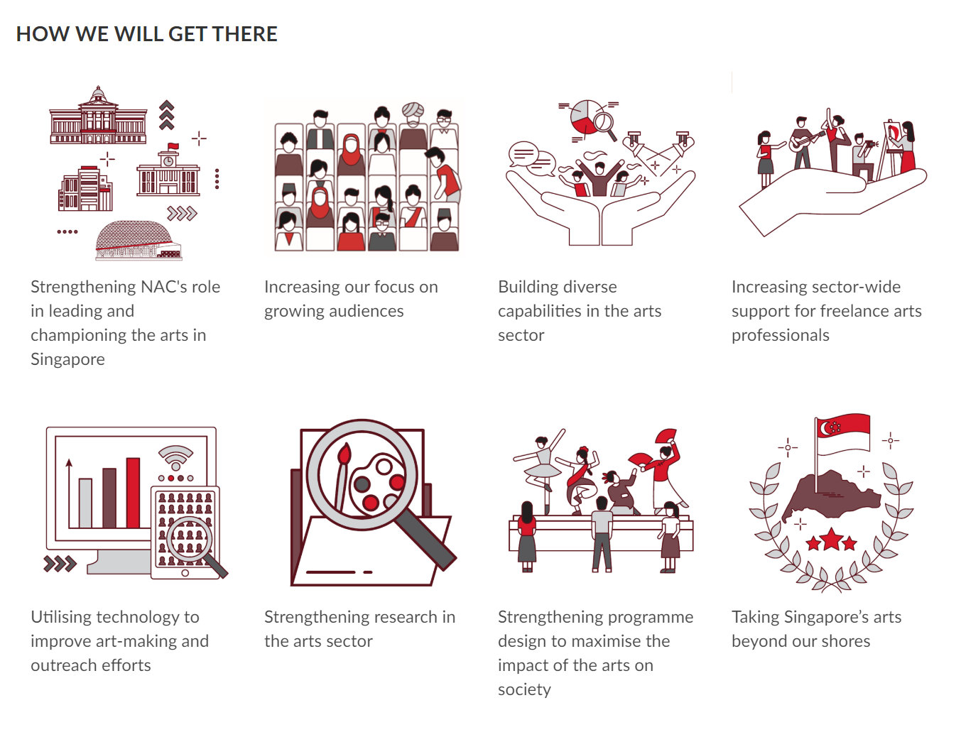
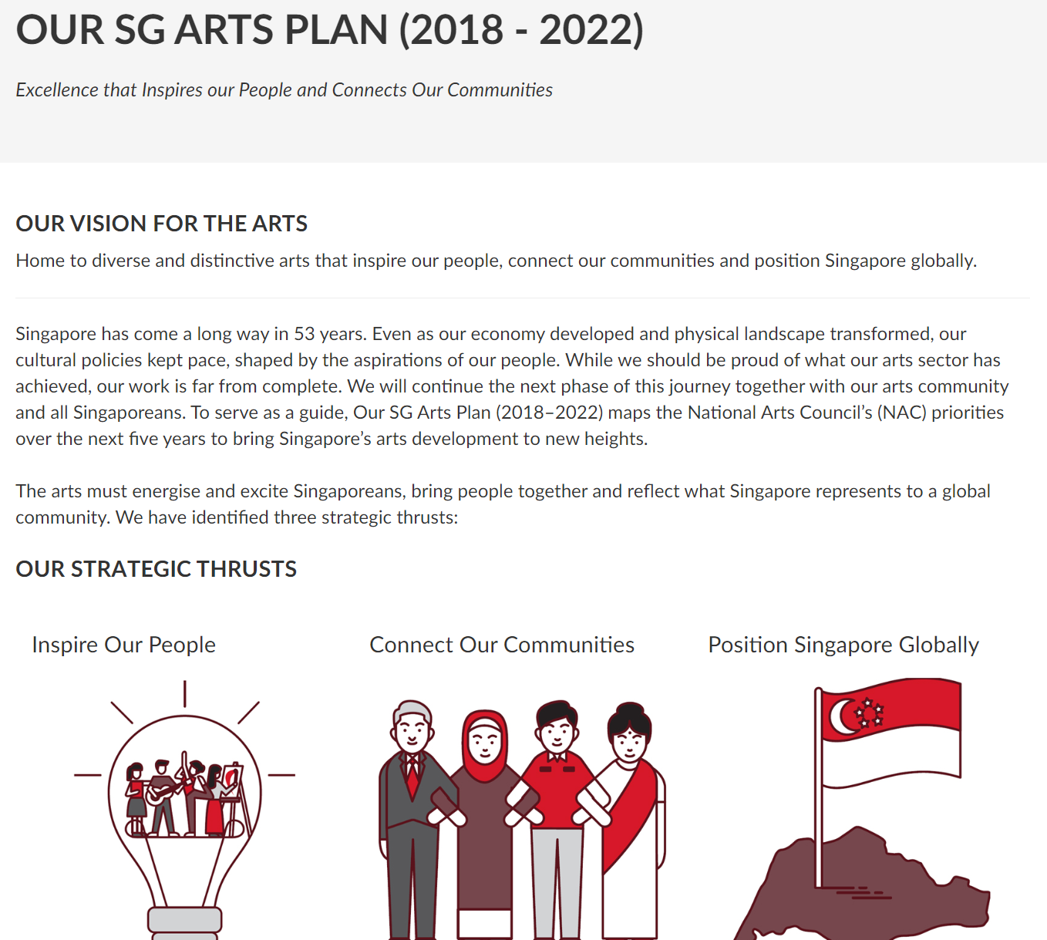
NAC - 5 year plan -increase outreach through use of technology
Notes:
https://www.nac.gov.sg/aboutus/Our-SG-Arts-Plan-2018-2022.html

Slide 35
Connexion collaborators
What
Collaborative art events held in Connexion that will be organized by the Connexion Collaborators, a club incharge of liaising with parties involved and planning these events.
when
Monthly
who
Connexion Collaborators, SMU ACF Clubs, SMU Students, Art Students, NAC, Arts-related Public
where
Connexion
How
Connexion Collaborators will invite different SMU ACF Clubs and other budding local artists to showcase their talents in their respective field of arts. Each month will feature a different field, e.g. Visual Arts, Photography
Notes:
So what is this Connexion Collaborators? Well, they are an SMU Student club that will be incharge of hosting monthly collaborative art events in Connexion. The parties that are involved are the Connexion Collaborators, SMU ACF clubs, SMU students, Art Students, NAC and the Arts-related public.
So hows this gonna work? Each month, the connexion collaborators will invite different SMU ACF clubs and other budding local artists to showcase their talents in their respective field of the arts. This will be fresh and exciting as each month will feature a different theme, for example, maybe this month we’ll feature visual arts, so we’ll get ACF clubs and other local artists involved in visual arts. Next month, maybe photography and so on.
14min to 12:25mins

Slide 36
THINKING HATS
[fine tuning our solution]
Facts
Planning
Evidence-based analysis of our solution
Emotion
Benefit
Initial skepticism when introducing this new concept
Mutual benefit among stakeholders
Creativity
judgement
Virtual Tours
Success of our marketing efforts for these events
Notes:
15min to 13mins to 9:30
We also used the 6 thinking hats model to fine tune our solution. Wearing the yellow hat, we found that there is mutual benefit to be gained among stakeholders. These benefits include increased exposure, gaining insights through collaborative work and providing a platform to connect stakeholders interested in the arts.
I will mention virtual tours under the green hat later.
For the black and red hats symbolising Judgement and Emotion, we were worried about initial skepticism when introducing this new concept and success of our marketing efforts for these events.
Jun Rong will run you through the white hat of Facts, which represents the evidence based analysis of our solution.

Slide 37
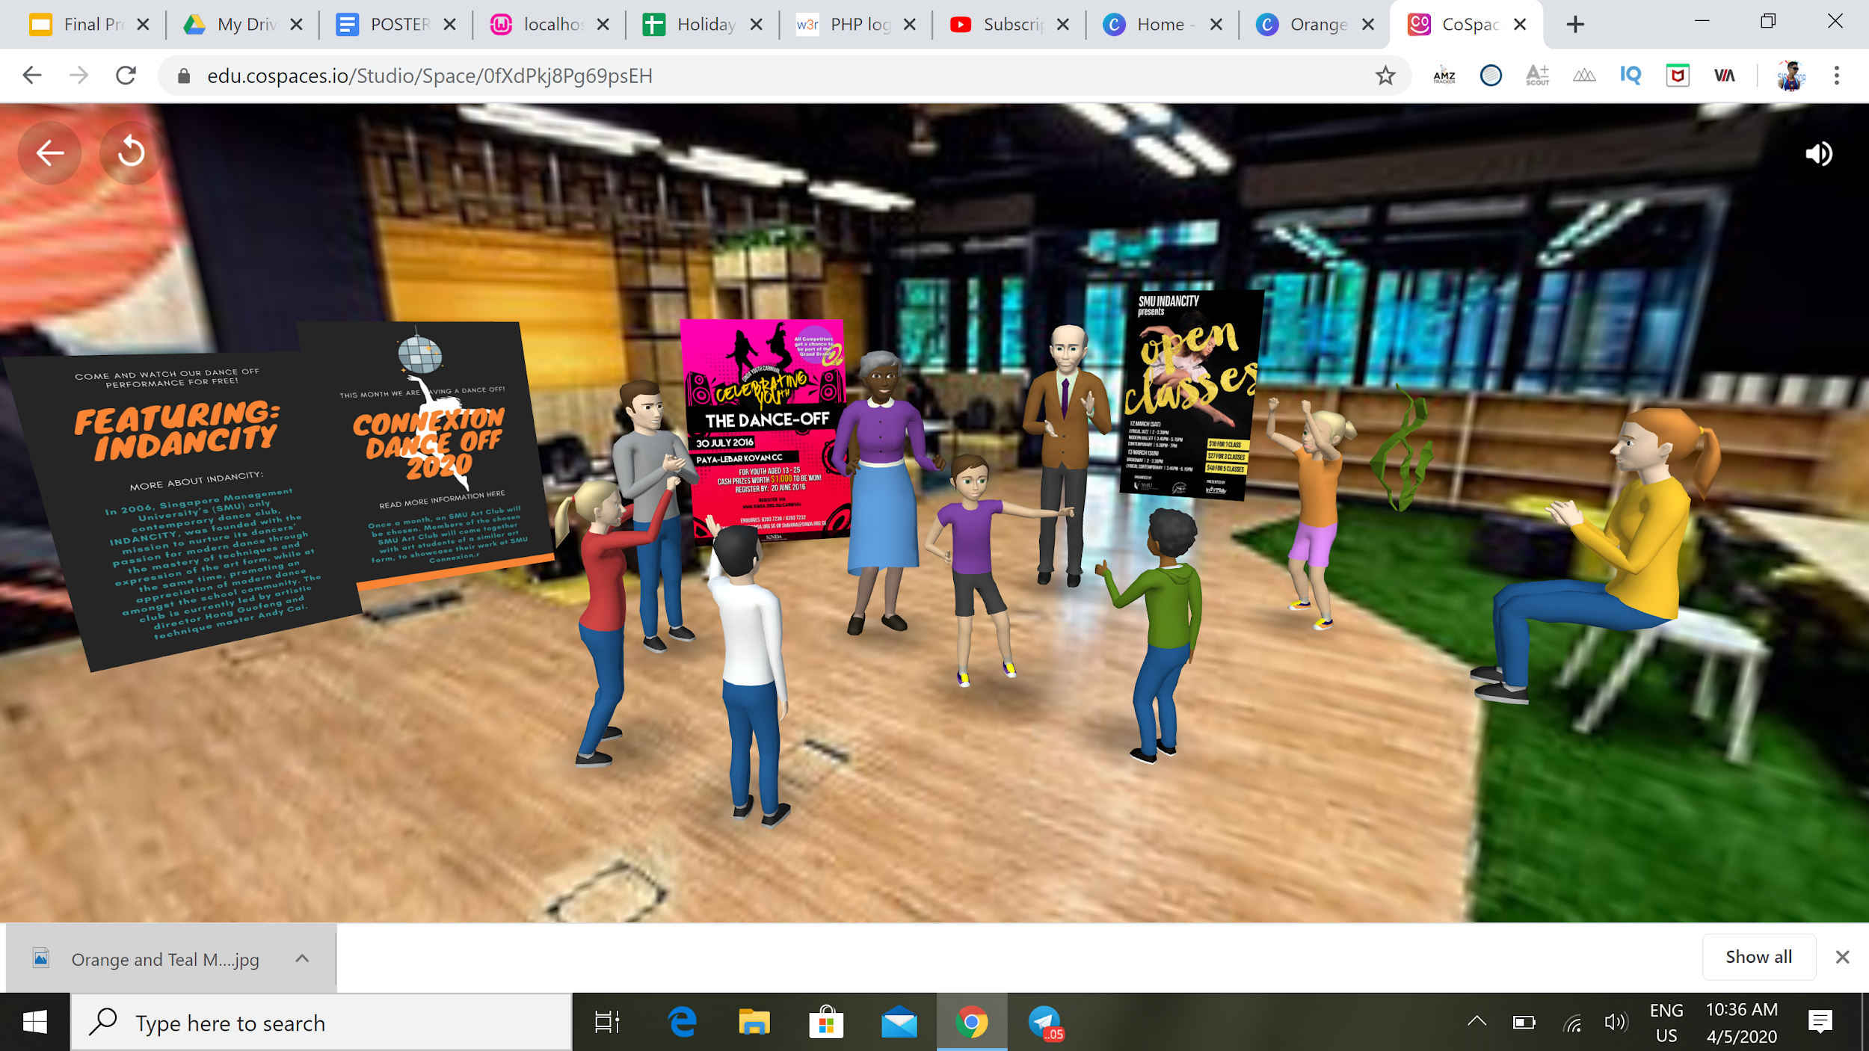
VIRTUAL TOUR
Public can go on the VR Tour and view the booths and read event information
We also have spots that features top artists and their works to increase exposure
Notes:
We will use a Virtual Tour during our marketing efforts to the public. They can go on the VR Tour to preview the booths and read event information. This is also one of the popular aspects that we found out from our opinion mining of tripadvisor reviews, that the public like detailed information and explanations about the event.
We will have spots that features local artists and their works to increase their exposure even within the virtual tour.
We hope that with a virtual tour, we can garner more interest for our event.

Slide 38

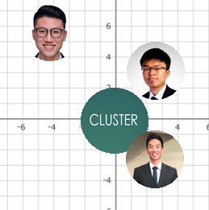
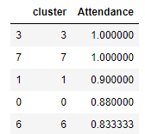
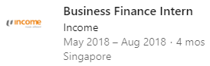
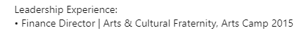
HOW WE ARE RECRUITING - identifying leads
clustering
Identify profiles
targeting
Cluster based on identified features
Extract cluster characteristic using mean/mode
Extracted 770 LinkedIn profiles
Infer score for each feature based on LinkedIn (e.g. Career oriented)
Collaborative filtering with KNN
Top profiles based on cosine distance
Pick 10 from every cluster to form a batch
Notes:
But the question here is how are we identifying these 30 people we need to form CC?
First, we cluster the survey data only using the features that were selected by the LR model earlier.
We then look at the clusters with highest attendance rates, and we can know the characteristics of each cluster by looking at the mean/mode of the data in that cluster.
Next, we collected 770 SMU student’s LinkedIn profiles.(To maintain their privacy, we have omitted any sensitive columns.)
Then, we mapped relevant details to our survey columns. For instance, the year and school can be directly extracted but for “career oriented” column, we need to infer this by the number of internships they took and its duration. Also, any previous arts CCAs or activities can also be extracted by looking at keywords like the names of arts CCA in SMU or the “art” keyword.
Lastly, to know who to target, we used a technique called collaborative filtering. The KNN model calculates a “distance” between the cluster characteristics(defined earlier), with all of our linkedin profiles. The most similar profiles will have a lower “distance” and we will pick top 10 profiles from each cluster to form our first batch of students to target. In this manner, we are likelier to capture people who are llikelier to be interested in a shorter amount of time and effort.

Slide 39
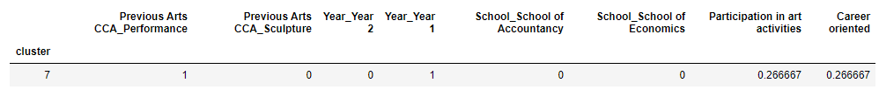
CLustering - Getting the characteristics
Cluster 7
For instance in this cluster, we took the mean of the last 2 columns and mode for the rest
This allows us to know the characteristics of each cluster for an easy matching process

Slide 40
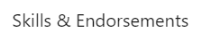
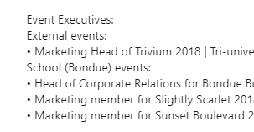
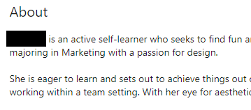
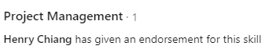
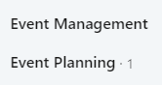
Evidence-based [who]
40.48% have had leadership positions such as president of a club or co-founder of a start-up
Topic modelling on summary section
Keywords: ‘experience’, ‘management’ & ‘team’
33% have project management skills
17% have planning-related skills
Notes:
These are the profiles of our identified students.
We observed that 40% of them have held or is holding leadership positions in and out of school, like being a president of a club or a founder of a startup.
We also performed topic modelling on their profile summaries, and keywords like “experience”, “management” and “team” appears, which reflects on their attitude and it fits with the idea of joining CC.
They also listed skills that were related to being a part of CC, like 33% having project management skills or 17% having planning related skills.
Hence, we can be confident that we can set up CC with a team of 30, and they will have the relevant skills to be either an exco member or a normal member.
15mins here

Slide 41
Evidence-based [what]
Fit independent logistic regression models using 2 columns as our “predicted” label
L1 Regularization to retain important features
The less they think local artists have enough exposure, the more likely they attend our event
Hence, featuring budding artists will intrigue them to participate
Attendance for art gallery
22 out of 30 students
73% predicted Attendance
Attendance for collaborative space
28 out of 30 students
93% predicted Attendance
Notes:
We move on to the evidences for choosing collaborative events as our activity instead of an art gallery or exhibition.
We fitted logistic regression models to our arts students survey, with each models predicting different column and feature selection was performed using regularization.
The predicted attendance for art gallery is about 73% while the attendance for collaborative spaces is 93%. Hence, we will choose collaborative events as our solution.
Interpreting the features that the model has selected, the more they found SMU convenient, or the more they visit SMU, the likelier they are to attend our event
Also, the less they feel local artists have enough exposure, the more likely they attend our event.
Hence, the students who come to our event thinks that local artists don't have enough exposure, and having our event catered to featuring only budding artists will intrigue them to participate.

Slide 42
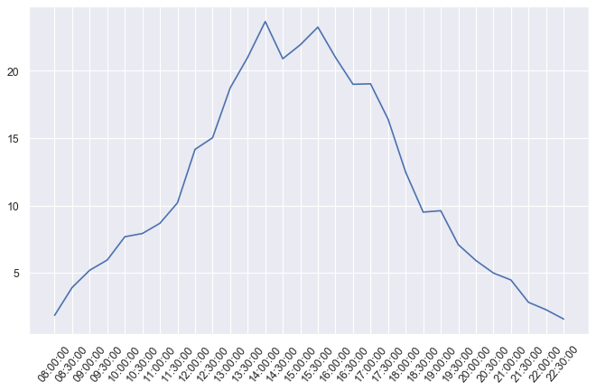

Evidence-based [when]
Bookings over time of day
Finding the overlap between the “popular times” and spare capacity at Connexion ( available booking timings)
FBS Bookings data over 1 month
Google Review popular timings
Days and Timings with a drop in bookings
Before 12pm and after 6pm
Saturdays and Sundays have least bookings
Based on the Google Review timings, the popular time to visit Arts related places is mid afternoon, friday night and weekends - synchronizes well if we hold our events on Friday after 6pm and on Saturday/Sundays
Bookings by day of week
Notes:
We want to find the overlap in timings to decide when to hold our event
We obtained booking data from FBS for Connexion over the course of 1 month, and we have discovered that
The spare capacity at Connexion is higher during weekends
And there is a drop in bookings before 12pm and after 6pm.
Based on the Google Review timings, our solution will synchronize well if we hold our events on Friday after 6pm and on weekends.

Slide 43
considerations
Arts CCAs in SMU
They will be willing to do this because they do not have to plan much as their own organic event
There will also be points that raise their club classification if they participate (which int urn can help them to get more funds)
Art students won't have classes on weekends and if they are passionate enough, they will sacrifice some time to come
Notes:
Since

Slide 44


Evidence-based [where]
Bookings by Floor Level
Bookings by Facility Type
Notes:
We can either look at floor level or facility level when determining the exact location to host our event at SMU Connexion.
This helps us to identify spaces that fulfills the requirements of the events.
For instance, if we want to hold an interactive networking event, we can look at bookings by floor level.
And we can observe that level 4, the heatmap shows that the jamming rooms for music activities and study booths at the side all have a low usage of less than 10%, and they are able to think of ways to use those spaces concurrently.
Alternatively, if they have specific requirements like holding workshops, then they can look at the bookings by facility type, which will show the underused facilities like integrated learning studio which is suitable for them.

Slide 45
considerations
They are able to book the facilities in advance, maybe 2 weeks in advance which is the same as SMU students
But we want to increase the usage of underutilized spaces without disrupting SMU students and faculties’ activities.
Hence, there is a need to encourage CC to take up underused facilities instead of regularly used facilities
Notes:
Since

Slide 46
04.
THE EVALUATION
Metrics to Track our Solution

Slide 47
MEtrics of success
Number of times Connexion is booked for art specific events
Tracked using FBS facilities under booking purpose
Number of visitors to events
Tracked using signups
Number of artists that attend
Tracked using the VR tour solution
Usage of virtual tour solution
Tracked using web metrics like time spent on website, number of clicks.

Slide 48
Thank You!
Do you have any Questions?
Notes:
Alright so heres an example of what the virtual tour will look like. Users can see previews on the next event. For example here we have a Dance off hosted by SMU Indancity. The users can also read more info about the actual event in the virtual tour.
Next we also showcase the actual artworks from budding artists in our virtual tour so they also can get even more exposure.
Thank you and we are open for any questions.

Slide 49
THANKS!
Does anyone have any questions?
youremail@freepik.com
+91 620 421 838
yourcompany.com

